Slide 1
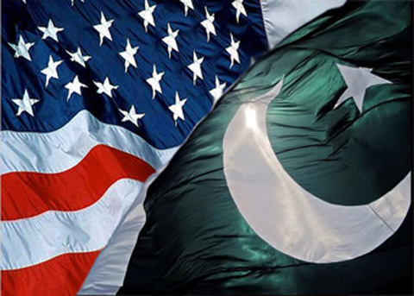
PAK-US RELATIONS Course: Pakistan Studies

Slide 2
Historical Background
The United States has had diplomatic relations with Pakistan since independence. The two countries' common interest is to maintain peace and stability in South Asia.
Historically Pak-US relationship has never been consistent. It went through many ups and downs in different periods. It was because of convergence and divergence of national interests that kept on switching both nations from friendship to friction.

Slide 3
Pakistan earned the title of ‘most allied ally’ of US in 1950s, 1980s and after the September 11, 2001, however, it is also the most sanctioned country in the world.
The relationship between US and Pakistan developed from some diplomatic exchanges in 1940s to close relationship in 1950s. This was the time when both nations entered into a Client-Patron relationship that was based on a clear asymmetry of military and economic power. Pakistan was completely dependent on US for defense against threats emanating from India, and Afghanistan.

Slide 4
Pre-Partition of Sub-Continent Pak-US relations are as old as Pakistan itself. The roots of these relations can be found in the pre-partition period. Initially the then American administration was against the idea of a divided India. The reason behind this opposition was the civil war in China, where the US supported nationalists against the communist elements. They wanted to avoid yet another major area of turmoil in Asia.

Slide 5
The Early Period
In the early years, the relations between the two countries were not cordial because of four important reasons.
First, the US had its global interests and its foreign policy had a global reach. It was the early phase of Cold War and the US was engaged in the containment of Communism. Therefore, priority was given to China and Japan and it had no major foreign policy concerns in South Asia. US policy makers were also of the opinion that Britain would play predominant role in South Asia

Slide 6
The second reason was a natural desire of Pakistan to cultivate brotherly relations with the Muslim countries. In this connection, Quaid-i-Azam frequently criticized western policy towards Palestine opposed the creation of Israel in 1948.
Thirdly, Pakistan also wished to keep itself out of the big powers’ conflict.
Fourthly, in the early days of emergence, Pakistan had to face numerous tribulations, such as, deprivation of economic and military assets, war on Kashmir with India, influx of refugees, 1000 miles long hostile Indian territory between East and West Pakistan, threat from North West Frontier because of Durand Line issue, and the scarcity of funds to meet the expenses of the government.

Slide 7
It was a time when Pakistan needed economic and military aid so as to overcome the critical security situation it had been plunged into. Pakistan made request of economic aid to US.
However, the request of $2 billion military and economic assistance, met a cold response from US and a meagre amount of $10 million was offered from its relief fund.13 Instead of giving military aid, on March 11, 1948, for the first time US imposed embargo on the export of military hardware to both the countries under the plea of Pakistan- India tension on Kashmir issue.

Slide 8
Cold War and Revisited US Policy
The Chinese revolution in 1949 alarmed US and compelled it to reconsider its Asian policy.
“The most significant aspect of Pakistan’s geo-strategic value for the US was its strategic and geographical position and Pakistan is one of the “rim- land” nation that ring communist core in Asia”
William Campbell

Slide 9
Pakistan during Cold War
In 1947 world was divided between two superpowers the USA and USSR.
It was difficult to remain neutral in the Cold War.
The US wanted an Asian ally to stand up against communism. By 1953, the US agreed to let Pakistan be that ally and signed the pact with Pakistan, Iran and Turkey.

Slide 10
The leadership of Pakistan was conscious to commit alliance with the West without a security guarantee not only against the Soviet Union but also vis-à-vis India.
The external challenge that influenced Pakistan’s foreign policy was a threat from Afghanistan because it refused to accept the North West Frontier Province (NWFP; now KP―Khyber Pakhtunkhwa) as a part of Pakistan and voted against Pakistan’s admission to the UN and kept reiterating its position on various other occasions.

Slide 11
Prime Minster Liaquat Ali Khan visited the United States in May, 1950. He did stress in his speeches that Pakistan and the United States share many common values such as democracy, freedom, equality and right of private ownership.
On trip, Pakistan was given anti- tank and anti-personnel mines for Pakistan Army.
The overall relations were not as warm as they would be in the coming years. An evidence of this low profile relationship was the Korean War in 1950-51, in which Pakistan refused to send troops, and only extended political support to the UN cause. However, in February 1951, under Four Point Program, the US sanctioned economic assistance of $600,000 to Pakistan.

Slide 12
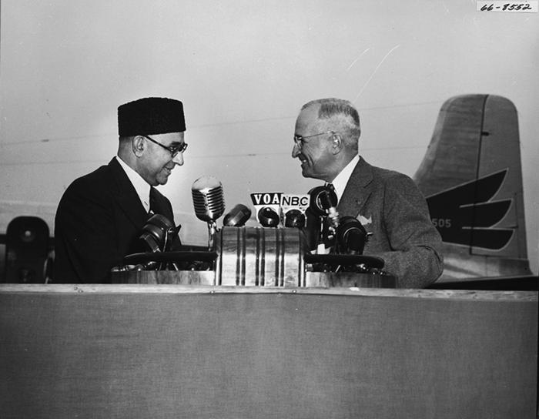
Prime Minister Liaquat Ali Khan with President Harry S. Truman
May, 1950

Slide 13
Period of Eisenhower
In 1953, Eisenhower assumed power and announced his doctrine of ‘Massive Retaliation’ that led US Administration to establish the new “Northern Tier of Defense” as an early goal of the administration.
Basically, the aim of Eisenhower administration was to reduce US involvement in other Korea- type operations, and build up instead the indigenous fighting capability of countries such as Pakistan, Iran, Turkey and Iraq―the frontline states.

Slide 14
Initially the relationship between Pakistan and US was not a sort of friendship but a patron-client relationship.
One, it was the time when Pakistan was fully dependent on US for defense against India and Afghanistan.
Second, during cold war period Pakistan was a crucial military factor for US in South Asia.
Third, the Patron-Client nature of relationship between Pakistan and US was well-known arrangement to other nations around the world.

Slide 15
SEATO
Patron-Client relationship established when Pakistan signed Mutual Defense Assistance Agreement with US in May 1954. This agreement was signed for building friendly cooperation in the economic, technical, and defense fields.
The main objective of this alliance was to block the advancement of Communism in Asia.Pakistan became the most allied ally of United States in Asia. It provided US with the facility to establish surveillance and communication post near Peshawar.
In return, US provided nearly $17.5 million military and $60 million economic aid.

Slide 16
CENTO
The Baghdad Pact was signed in 1955 with Iran, Iraq, Turkey and Britain.
Later renamed as Central Asia Treaty Organization in 1959 when Iraq withdrew from it.
Basically it was designed to counter Soviet Influence in the Middle East.
This Pact was expired in 1979.

Slide 17

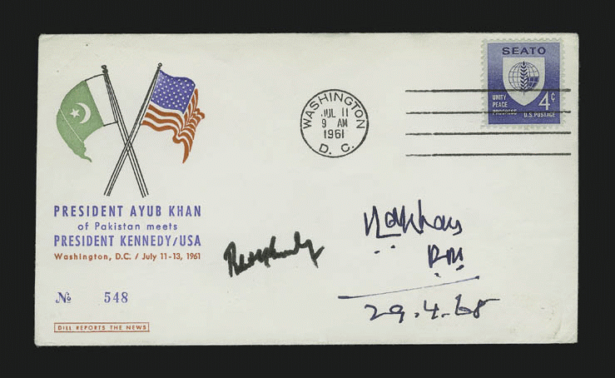
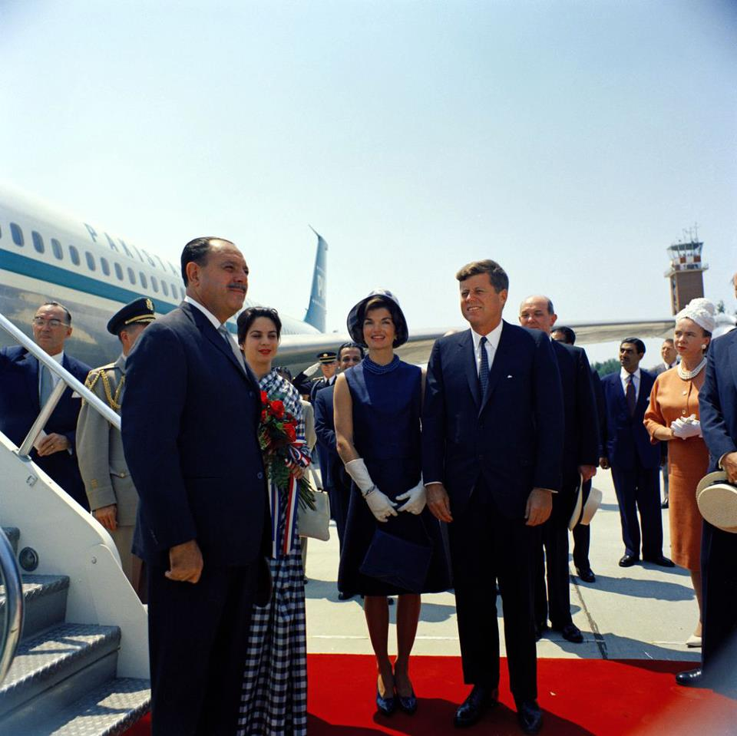
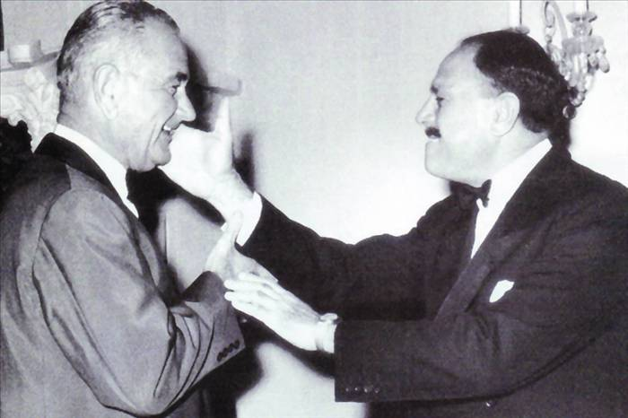
President Kennedy Receiving President Ayub at Andrews AFB

Slide 18
The Period of Kennedy
The fluctuation started in Pak-US relations.
The U-2 incident of May 1960, and the Cuban Missile Crisis in October 1962, compelled both US and Soviet Union to realize the intensity of the rivalry.
The Kennedy administration regarded China as a greater threat to the free world than the Soviet Union. It was also the time when US administration tried to reduce the rent, it paid for the Peshawar base and decreased military assistance program.
Pakistan joined the alliance system in order to have advantage over its adversary, India. On the other hand, during the Sino-Indian conflict 1962, US and Britain decided to give $120 million military assistance to India.
This development under the Kennedy administration decreased the alliance co-relation with aid.

Slide 19
Relations with US during and After the Wars
During Indo-China war of 1962, US supplied military aid to India. This military aid shook Pak-US relations.
Pakistan was unhappy because US did not use the opportunity to settle Kashmir issue.
President Ayub Khan turned to China and the Soviet Union in 1965 to maintain the balance of power.
In result the United States imposed EMBARGO on arms during Indo-Pak war of 1965.
Resumed non-military aid later in 1966

Slide 20
Shift in the US Policy
At the end of 1965 War, US policy towards Pakistan entered into a period of neglect. There were several reasons for this shift in US policy.
Firstly, the decision makers of US decided that Indo-Pak conflict had diverted both the countries from genuine regional accord, and the American arms were being wasted.
Secondly, it was a time when détente between two global powers was growing. The anti-Soviet passions were dying down and US was engaged in crucial dialogue on the control of nuclear weapons. During this period the strategic and political interests of Pakistan and US failed to coincide with each other.

Slide 21
The Period of Nixon
In 1971, Henry Kissinger made a secret trip to China via Islamabad that paved the way for the Sino-US détente. It reduced US security concerns in South Asia and improved Pakistan’s relations with US. At the same time, India and the Soviet Union signed the treaty of friendship and cooperation.
India intervened in East Pakistan in 1971 that prompted the third Indo-Pak War, resulting in the dismemberment of Pakistan. The dismemberment of Pakistan in 1971 led US recognize India as the preeminent power in South Asia.
The event of 1971, practically made Pakistan’s membership in SEATO absurd and, thus it joined Non- Alignment Movement. It continued its membership in CENTO, more in respect to its ties with Iran and Turkey, than because of its relationship with US

Slide 22
The Period of Jimmy Carter
In 1979, President Jimmy Carter took office in the US. He emphasized on nuclear non-proliferation. Therefore, the Carter administration not only forced Pakistan, not to acquire nuclear capability, but also pressurized France for the suspension of its agreement with Pakistan on sale of nuclear processing plant(Agreement in1976s).
Moreover, in 1979, a mob under mistaken belief that America was behind the attack on the Great Mosque in Makkah burnt down American embassy in Islamabad in which some of the embassy members died.

Slide 23
Soviet Invasion of Afghanistan
The December 1979 Soviet military intervention in Afghanistan and the Islamic revolution in Iran caused marked changes in US foreign policy towards Pakistan. Soviet intervention in Afghanistan created for Pakistan a two-front security situation i.e. East and West.
Pakistan became ‘front line’ state for the US in the war against communism.

Slide 24
The Reagan Administration
The Reagan administration had three major objectives in South Asia:
1. To contain Soviet Union
2. To lessen Indian dependence on the Soviet Union
3. Nuclear non-proliferation President Reagan tried to cultivate closer ties with Pakistan.
US signed an agreement of $3.2 billion assistance for Pakistan in 1981, which was extended over a period of six years (1981-87).
In the spring of 1986, another package of $4.2 billion for the period 1988-93 was sanctioned. This aid package included the sale of sophisticated aircraft like F-16.

Slide 25
Relations after the Cold war: 1988-1999
After the restoration of democracy after the disastrous and mysterious death of Zia and U.S. Ambassador in an aviation crash.
Relations deteriorated quickly with upcoming prime ministers Benazir Bhutto and Nawaz Sharif.
The United States took tough stand on Pakistan's nuclear development, passing the Pressler Amendment (suspension of military and economic aid), while significantly improving the relations with India.

Slide 26
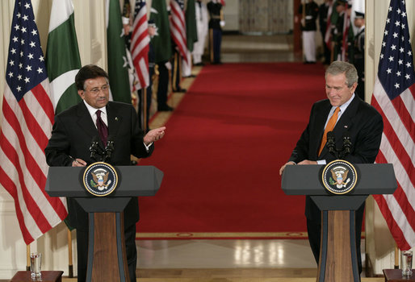
Pak-US Relations After 9/11

Slide 27
9/11 (video)

Slide 28
Conclusion
After reviewing the relationship between Pakistan and the US during different phases one reaches the conclusion that relations between them have always been marked by convergence and divergence of national interests, resulting in a cycle of friendship and friction.

